Slide 1
Predicting Energy Usage in California
-UCI Capstone 2023
Frank Dong, Yang Weng, Nima Hendi, Sean Lee

Slide 2
Introduction
Project objective: clear statement of the problem
Available data + sources
In this project, we want to develop a system to forecast energy usage per sector (residential, commercial, industrial) and per source for California.
Notes:
Meeting 1

Slide 3
Project Summary (California)
Based on historical data from 1960 to 2020, from CA and US. (more than 10,000 features)
Prediction for the next 2 year (2020-2022), 5 year (2020-2025),and 10 year (2020-2030).
Prediction for energy uses for Residential, commencial, industrial, Transportation and Total consumption.
Prediction for energy uses for Coal, Natural Gas, Petroleum, Nuclear, Renewable Energy.

Slide 4
Data Description and Management
Link to data slide decks: data_uci_capstone
Predicting energy uses:
https://docs.google.com/presentation/d/1zvVwxJ04zf214ujSyKs-WahalehKll8IFVgxumDou5M/edit?usp=sharing
SQL database Github Repository
In this project, we will be using data from U.S. Energy Information Administration (https://www.eia.gov/totalenergy/data) and California Energy Commission website (https://www.energy.ca.gov/data-reports). We will be working on datasets that provide monthly energy usage, effects of temperature, and different needs of resources for different sectors. The data sets will be in CSV and EXCEL formats.
Notes:
Meeting 2

Slide 5
Database (PostgreSql)
Database store more than ten thousands different features, combined from different category of energy uses, and price.
Data are linked together by MSN index, MSN translation included in data file.
Independent variable: price and consumption table named (All and Price_CA)
Target variable: 5 energy source table and 5 energy sector table.

Slide 6
Data Pipeline
Concatenate target variable and response variable
Transform the data base to be list of features
Convert the value to numerical
Fill in all the NA with 0 (Considering filling with mean value instead)
Data Normalization

Slide 7
Sample (unnormalized):
Residential Energy Consumption Prediction vs price features (named in MSB index):
Predict next year(or specified year) energy consumption based on other given prices.
Years | ARICD | … | ZWCDP | Residential CA
1970 | 0.49 | … | 3169 | 1192848
… | … | … | … | …
2020 | 12.56 | … | 2539 | 1507721

Slide 8
Data Visualization
Notes:
Meeting 2

Slide 9
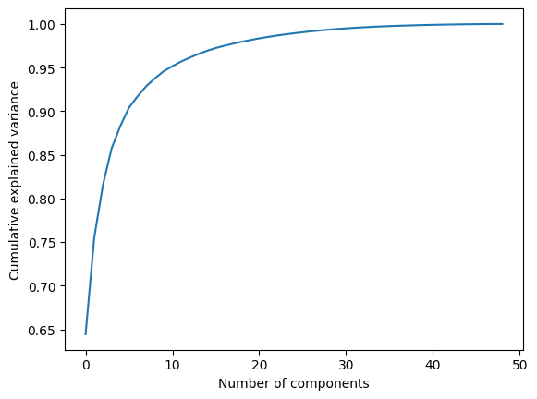
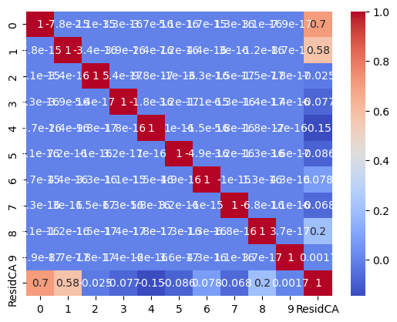
PCA analysis
Select 10 as hyperparameter for pca analysis

Slide 10
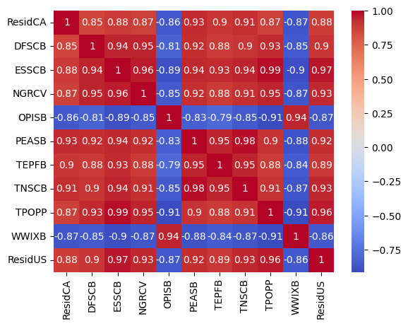
Correlation analysis
Two year Residential Sector Prediction Sample
Select features with high correlation with target (>0.85)
Eliminate duplicate features:
# TNASB & PEASB
# OPSCB & OPISB
Features from 306 down to 11

Slide 11
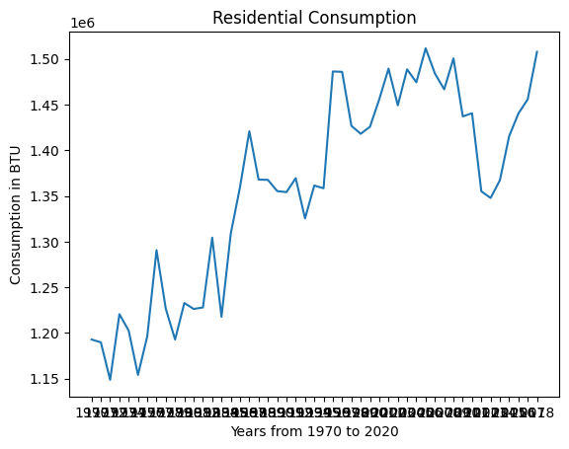
Sample target
Residential Consumption in CA
Residential consumption growth over years.

Slide 12
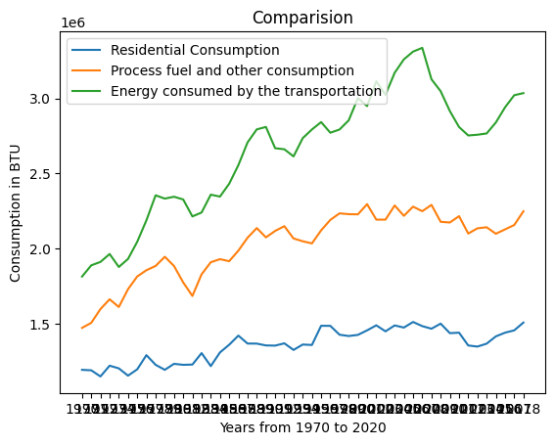
Sample Relation
Residential Consumption in CA
Residential consumption Compare with main features

Slide 13
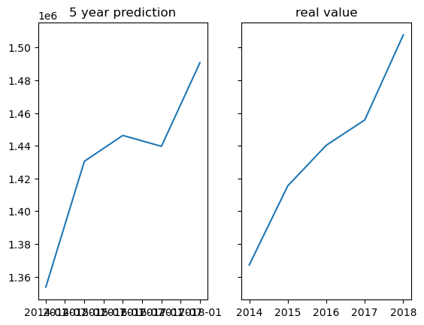
SARIMAX Validation
5 year prediction based on pca data
MAPE: 0.009399553213092346

Slide 14
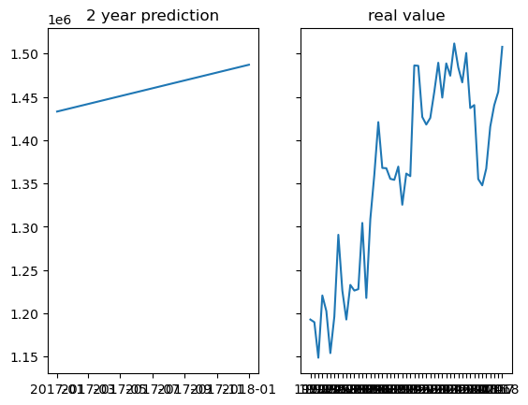
SARIMAX Prediction
2 year prediction based on pca data

Slide 15
Milestone
● Winter
○ Weeks 8-10 Data sets Collection and Combination
(PostgreSQL database, github repo)
● Spring
○ Weeks 1-2 Data sets EDA
(Method defined and validated, applying to other models)
○ Weeks 3-4 Statistic Model fit, and Machine learning Model fit
(SARIMAX model applied, working on other models)
○ Weeks 5-6 Model validation and visualization
(SARIMAX model applied, working on other models)
○ Weeks 7-8 Model analyze
(SARIMAX model applied, working on other models)
○ Weeks 9-10 Final report
We cleaned the data, wrangled data and partial analysis and modeling.
Now we are heading to dig deeper in analysis and apply other model for comparisons.

